Slide 1
Architectural Patterns and Styles
Mahesh Shirole
Microsoft Application Architecture Guide

Slide 2
Architectural Style
An architectural style, sometimes called an architectural pattern, is a set of principles—
a coarse grained pattern that provides an abstract framework for a family of systems
It improves partitioning and promotes design reuse by providing solutions to frequently recurring problems
Architectural Style provides
a common language
facilitates a higher level of conversation
conversation is inclusive of patterns and principles without getting into specifics
Category | Architecture Style
Communication | Service-Oriented Architecture (SOA), Message Bus
Deployment | Client-Server, 3 Tier, N-Tier
Domain | Domain Driven Design
Structure | Component-Based, Object-Oriented, Layered Architecture

Slide 3
Architectural Styles
Client Server
Segregates the system into two applications, where the client makes requests to the server. In many cases, the server is a database with application logic represented as stored procedures
Component-Based Architecture
Decomposes application design into reusable functional or logical components that expose well-defined communication interfaces
Domain Driven Design
An object-oriented architectural style focused on modeling a business domain and defining business objects based on entities within the business domain

Slide 4
Architectural Styles
Layered Architecture
Partitions the concerns of the application into stacked groups (layers)
Message Bus
An architecture style that prescribes use of a software system that can receive and send messages using one or more communication channels, so that applications can interact without needing to know specific details about each other
N-Tier/3-Tier
Segregates functionality into separate segments in much the same way as the layered style, but with each segment being a tier located on a physically separate computer

Slide 5
Architectural Styles
Object Oriented
A design paradigm based on division of responsibilities for an application or system into individual reusable and self-sufficient objects, each containing the data and the behavior relevant to the object
Service Oriented Architecture
Refers to applications that expose and consume functionality as a service using contracts and messages

Slide 6
System – Combination of Architectural Styles
The architecture of a software system is a combination of architectural styles that make up the complete system
Web Application
separation of concerns by using the layered architecture style
deploy the application using the 3-tier deployment
use a separated presentation pattern - a type of layered design style, such as Model-View-Controller (MVC) for your interaction model
Desktop Application- a client that sends requests to a program on the server
deploy the client and server using the client/server architecture style
use the component-based architecture style to decompose the design further into independent components
use the object-oriented design approach for these components will improve reuse, testability, and flexibility

Slide 7
Client/Server Architectural Style
The client/server architectural style describes distributed systems that involve a separate client and server system, and a connecting network
The simplest form of client/server system involves a server application that is accessed directly by multiple clients (2-Tier architectural style)
The client initiates one or more requests (perhaps using a graphical UI), waits for replies, and processes the replies on receipt
The server typically authorizes the user and then carries out the processing required to generate the result
The client/server architectural style is suitable when you want to centralize data storage, backup, and management functions, or when your application must support different client types and different devices

Slide 8
Variations of Client/Server Architectural Style
Client-Queue-Client Systems:
This approach allows clients to communicate with other clients through a server-based queue
Clients can read data from and send data to a server that acts simply as a queue to store the data
This allows clients to distribute and synchronize files and information
This is sometimes known as a passive queue architecture

Slide 9
Variations of Client/Server Architectural Style
Peer-to-Peer (P2P) Applications:
Developed from the Client-Queue-Client style,
P2P style allows the client and server to swap their roles in order to distribute and synchronize files and information across multiple clients
It extends the client/server style through
multiple responses to requests,
shared data,
resource discovery, and
resilience to removal of peers

Slide 10
Variations of Client/Server Architectural Style
Application Servers:
A specialized architectural style where the server hosts and executes applications and services that a thin client accesses through a browser or specialized client installed software
An example is a client executing an application that runs on the server through a framework such as Terminal Services

Slide 11
Benefits of Client/Server Architectural Style
Higher security
All data is stored on the server, which generally offers a greater control of security than client machines
Centralized data access
Because data is stored only on the server, access and updates to the data are easier to administer than in other architectural styles
Ease of maintenance
Roles and responsibilities of a computing system are distributed among several servers that are known to each other through a network
This ensures that a client remains unaware and unaffected by a server repair, upgrade, or relocation

Slide 12
Component-Based Architectural Style
Focuses on the decomposition of the design into individual functional or logical components that expose well-defined communication interfaces containing methods, events, and properties
Provides a higher level of abstraction than object-oriented design principles
This style is useful if you want to create a pluggable or composite architecture that allows you to easily replace and update individual components

Slide 13
Component-Based Architectural Style Key Design Principles
Reusable
Components are usually designed to be reused in different scenarios in different applications
Replaceable
Components may be readily substituted with other similar components
Not context specific
Components are designed to operate in different environments and contexts
Extensible
A component can be extended from existing components to provide new behavior
Independent
Components are designed to have minimal dependencies on other components
Therefore components can be deployed into any appropriate environment without affecting other components or systems

Slide 14
Component-Based Architectural Style
Examples:
user interface components such as grids and buttons (often referred to as controls),
helper and utility components that expose a specific subset of functions used in other components
Components depend upon a mechanism within the platform that provides an environment in which they can execute, often referred to as component architecture
Component object model (COM) and distributed component object model (DCOM) in Windows
Common Object Request Broker Architecture (CORBA) and Enterprise JavaBeans (EJB) on other platforms

Slide 15
Benefits of Component-Based Architectural Style
Ease of deployment
As new compatible versions become available, you can replace existing versions with no impact on the other components or the system as a whole
Reduced cost
The use of third-party components allows you to spread the cost of development and maintenance
Ease of development
Components implement well-known interfaces to provide defined functionality, allowing development without impacting other parts of the system
Reusable
The use of reusable components means that they can be used to spread the development and maintenance cost across several applications or systems

Slide 16
Domain Driven Design Architectural Style
Domain Driven Design (DDD) is an object-oriented approach to designing software based on the business domain, its elements and behaviors, and the relationships between them
The domain model can be viewed as a framework from which solutions can then be rationalized
Apply DDD if you have a complex domain and you wish to improve communication and understanding within your development team, or where you must express the design of an application in a common language that all stakeholders can understand

Slide 17
Benefits of Domain Driven Design Architectural Style
Communication
All parties within a development team can use the domain model and the entities it defines to communicate business knowledge and requirements using a common business domain language, without requiring technical jargon
Extensible
The domain model is often modular and flexible, making it easy to update and extend as conditions and requirements change
Testable
The domain model objects are loosely coupled and cohesive, allowing them to be more easily tested

Slide 18
Layered Architectural Style
Layered architecture focuses on the grouping of related functionality within an application into distinct layers that are stacked vertically on top of each other
Functionality within each layer is related by a common role or responsibility
Communication between layers is explicit and loosely coupled
The layered architectural style is also appropriate if
your application must support different client types and different devices, or
you want to implement complex and/or configurable business rules and processes

Slide 19
Layered Architectural Style
The layers of an application
may reside on the same physical computer (the same tier)
may be distributed over separate computers (n-tier), and
the components in each layer communicate with components in other layers through well-defined interfaces
For example, a typical Web application design consists of
a presentation layer (functionality related to the UI),
a business layer (business rules processing), and
a data layer (functionality related to data access, often almost entirely implemented using high-level data access frameworks)

Slide 20
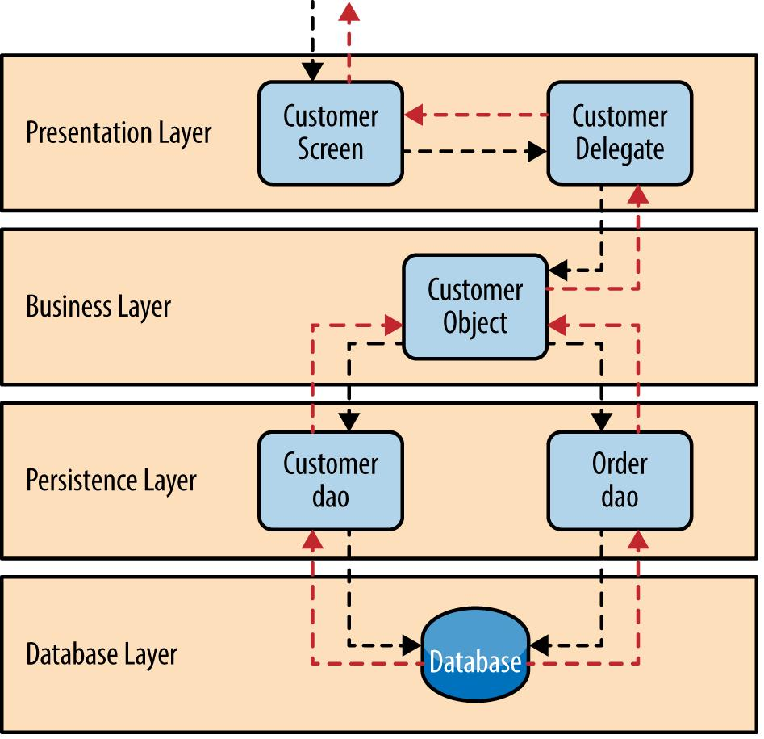
https://www.safaribooksonline.com/library/view/software-architecture-patterns/9781491971 437/ch01.html

Slide 21
Layered Architectural Style Key Design Principles
Abstraction
Layered architecture abstracts the view of the system as whole while providing enough detail to understand the roles and responsibilities of individual layers and the relationship between them
Encapsulation
No assumptions need to be made about data types, methods and properties, or implementation during design, as these features are not exposed at layer boundaries
Clearly defined functional layers
The separation between functionality in each layer is clear
Upper layers such as the presentation layer send commands to lower layers, such as the business and data layers, and may react to events in these layers, allowing data to flow both up and down between the layers

Slide 22
Layered Architectural Style Design Principles
High cohesion
Well-defined responsibility boundaries for each layer, and ensuring that each layer contains functionality directly related to the tasks of that layer, will help to maximize cohesion within the layer
Reusable
Lower layers have no dependencies on higher layers, potentially allowing them to be reusable in other scenarios
Loose coupling
Communication between layers is based on abstraction and events to provide loose coupling between layers

Slide 23
Separated Presentation Patterns
Separated Presentation patterns encompass a range of patterns that
the handling of the user’s interactions from the UI, the presentation and business logic, and the application data with which the user works
Separation of concerns: divide UI processing concerns into distinct roles
MVC pattern has three roles: the Model, the View, and the Controller.
The Model represents data (perhaps a domain model that includes business rules);
the View represents the UI; and
the Controller handles requests, manipulates the model, and performs other operations
Event-based notification
The Observer pattern is commonly used to provide notifications to the View when data managed by the Model changes
Delegated event handling
The controller handles events triggered from the UI controls in the View

Slide 24
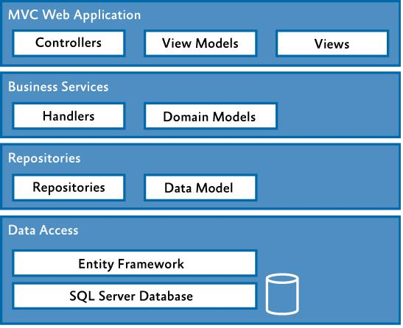
https://msdn.microsoft.com/en-us/library/hh404093.aspx

Slide 25
Benefits of Layered Architectural Style Design Principles
Abstraction
Layers allow changes to be made at the abstract level.
You can increase or decrease the level of abstraction you use in each layer of the hierarchical stack
Isolation
Allows you to isolate technology upgrades to individual layers in order to reduce risk and minimize impact on the overall system
Manageability
Separation of core concerns helps to identify dependencies, and organizes the code into more manageable sections
Performance
Distributing the layers over multiple physical tiers can improve scalability, fault tolerance, and performance
Testability
Increased testability arises from having well-defined layer interfaces

Slide 26
Message Bus Architectural Style
Message bus architecture facilitate software systems to receive and send messages using one or more communication channels
It is a style for designing applications where interaction between applications is accomplished by passing messages (usually asynchronously) over a common bus
The most common implementations of message bus architecture are
A messaging router
A Publish/Subscribe pattern
A messaging system such as Message Queuing
This style is also appropriate if you are implementing a task that requires interaction with external applications, or applications hosted in different environments

Slide 27
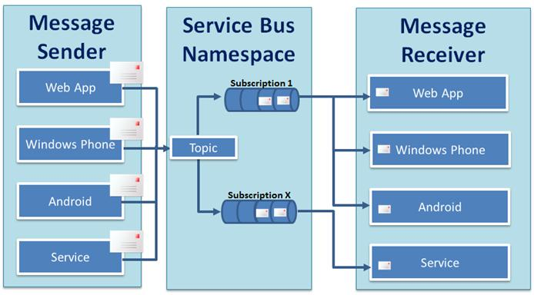
https://blogs.msdn.microsoft.com/brunoterkaly/2012/01/04/cloud-architecture-series-durable-messages-using-windows-azure-cloud-service-bus-queuesestablishing-your-service-through-the-portal/

Slide 28
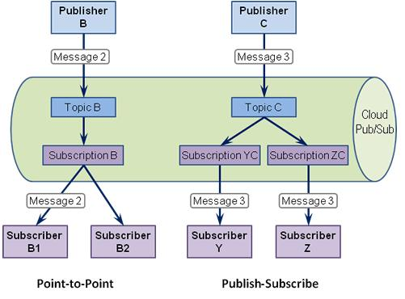
http://www.enterpriseintegrationpatterns.com/patterns/messaging/PublishSubscribeChannel.html

Slide 29
Message Bus Architectural Style
A message bus provides the ability to handle:
Message-oriented communications
All communication between applications is based on messages that use known schemas
Complex processing logic
Complex operations can be executed by combining a set of smaller operations, each of which supports specific tasks, as part of a multistep itinerary
Modifications to processing logic
Because interaction with the bus is based on common schemas and commands, you can insert or remove applications on the bus to change the logic that is used to process messages
Integration with different environments
By using a message-based communication model based on common standards, you can interact with applications developed for different environments, such as Microsoft .NET and Java

Slide 30
Message Bus Architectural Style
Variations on the message bus style include:
Enterprise Service Bus (ESB)
Based on message bus designs, an ESB uses services for communication between the bus and components attached to the bus
An ESB will usually provide services that transform messages from one format to another, allowing clients that use incompatible message formats to communicate with each other
Internet Service Bus (ISB)
This is similar to an enterprise service bus, but with applications hosted in the cloud instead of on an enterprise network
A core concept of ISB is the use of Uniform Resource Identifiers (URIs) and policies to control the routing of logic through applications and services in the cloud

Slide 31
Benefits of Message Bus Architectural Style
Extensibility
Applications can be added to or removed from the bus without having an impact on the existing applications
Low complexity
Application complexity is reduced because each application only needs to know how to communicate with the bus
Flexibility
The set of applications that make up a complex process, or the communication patterns between applications, can be changed easily to match changes in business or user requirements, simply through changes to the configuration or parameters that control routing

Slide 32
Benefits of Message Bus Architectural Style
Loose coupling
As long as applications expose a suitable interface for communication with the message bus, there is no dependency on the application itself, allowing changes, updates, and replacements that expose the same interface
Scalability
Multiple instances of the same application can be attached to the bus in order to handle multiple requests at the same time
Application simplicity
Although a message bus implementation adds complexity to the infrastructure, each application needs to support only a single connection to the message bus instead of multiple connections to other applications

Slide 33
N-Tier / 3-Tier Architectural Style
Architectural deployment styles that describe the separation of functionality into segments (same way as the layered style) where each segment being a tier that can be located on a physically separate computer
Each tier is completely independent from all other tiers, except for those immediately above and below it
The nth tier only has to know
how to handle a request from the n+1th tier, how to forward that request on to the n-1th tier (if there is one),
how to handle the results of the request
Communication between tiers is typically asynchronous in order to support better scalability
The N-tier or the 3-tier architectural style is also appropriate if you want to be able to share business logic between applications, and you have sufficient hardware to allocate the required number of servers to each tier

Slide 34
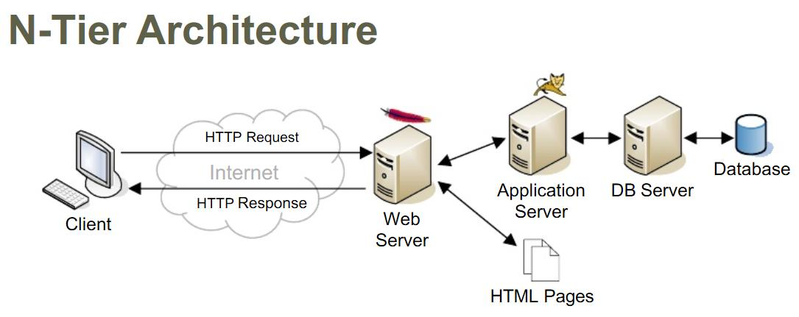
https://dbinfoworld.wordpress.com/tag/database-architecture/

Slide 35
Benefits of N-Tier / 3-Tier Architectural Style
Maintainability
Because each tier is independent of the other tiers, updates or changes can be carried out without affecting the application as a whole
Scalability
Because tiers are based on the deployment of layers, scaling out an application is reasonably straightforward
Flexibility
Because each tier can be managed or scaled independently, flexibility is increased
Availability
Applications can exploit the modular architecture of enabling systems using easily scalable components, which increases availability

Slide 36
Object-Oriented Architectural Style
Object-oriented architecture is a design paradigm based on the division of responsibilities for an application or system into individual reusable and self-sufficient objects, each containing the data and the behavior relevant to the object
Objects are discrete, independent, and loosely coupled; they communicate through interfaces, by calling methods or accessing properties in other objects, and by sending and receiving messages
Consider the object-oriented architectural style if you want to model your application based on real world objects and actions
The object-oriented style is also suitable if you must encapsulate logic and data together in reusable components or you have complex business logic that requires abstraction and dynamic behavior

Slide 37
Object-Oriented Architectural Style Key Principles
Abstraction
This allows you to reduce a complex operation into a generalization that retains the base characteristics of the operation.
For example, an abstract interface can be a well-known definition that supports data access operations using simple methods such as Get and Update
Composition
Objects can be assembled from other objects, and can choose to hide these internal objects from other classes or expose them as simple interfaces
Inheritance
Objects can inherit from other objects, and use functionality in the base object or override it to implement new behavior.
Moreover, inheritance makes maintenance and updates easier, as changes to the base object are propagated automatically to the inheriting objects

Slide 38
Object-Oriented Architectural Style Key Principles
Encapsulation
Objects expose functionality only through methods, properties, and events, and hide the internal details such as state and variables from other objects
This makes it easier to update or replace objects, as long as their interfaces are compatible, without affecting other objects and code.
Polymorphism
This allows you to override the behavior of a base type that supports operations in your application by implementing new types that are interchangeable with the existing object
Decoupling
Objects can be decoupled from the consumer by defining an abstract interface that the object implements and the consumer can understand
This allows you to provide alternative implementations without affecting consumers of the interface

Slide 39
Benefits of Object-Oriented Architectural Style
Understandable
It maps the application more closely to the real world objects, making it more understandable
Reusable
It provides for reusability through polymorphism and abstraction
Testable
It provides for improved testability through encapsulation
Extensible
Encapsulation, polymorphism, and abstraction ensure that a change in the representation of data does not affect the interfaces that the object exposes, which would limit the capability to communicate and interact with other objects
Highly Cohesive
By locating only related methods and features in an object, and using different objects for different sets of features, you can achieve a high level of cohesion

Slide 40
Service-Oriented Architectural Style
Service-oriented architecture (SOA) enables application functionality to be provided as a set of services, and the creation of applications that make use of software services.
Services are loosely coupled because they use standards-based interfaces that can be invoked, published, and discovered.
Services in SOA are focused on providing a schema and message-based interaction with an application through interfaces that are application scoped, and not component or object-based
Consider the SOA style if
You have access to suitable services that you wish to reuse; can purchase suitable services provided by a hosting company
Want to build applications that compose a variety of services into a single UI
You are creating Software plus Services (S+S), Software as a Service (SaaS), or cloud-based applications

Slide 41
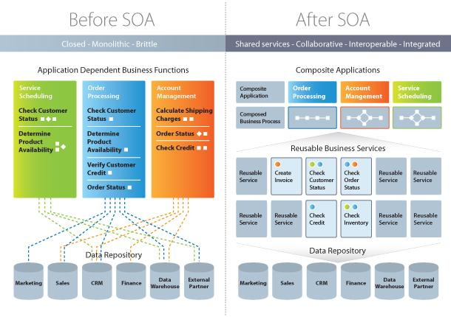
http://www.tridens.si/expertise/soa/

Slide 42
Service-Oriented Architectural Style Key Principles
Services are autonomous
Each service is maintained, developed, deployed, and versioned independently
Services are distributable
Services can be located anywhere on a network, locally or remotely, as long as the network supports the required communication protocols
Services are loosely coupled
Each service is independent of others, and can be replaced or updated without breaking applications that use it as long as the interface is still compatible
Services share schema and contract, not class
Services share contracts and schemas when they communicate, not internal classes
l
Compatibility is based on policy
Policy in this case means definition of features such as transport, protocol, and security

Slide 43
Benefits of Service-Oriented Architectural Style
Domain alignment
Reuse of common services with standard interfaces increases business and technology opportunities and reduces cost
Abstraction
Services are autonomous and accessed through a formal contract, which provides loose coupling and abstraction
Discoverability
Services can expose descriptions that allow other applications and services to locate them and automatically determine the interface
Interoperability
Because the protocols and data formats are based on industry standards, the provider and consumer of the service can be built and deployed on different platforms

